Slide 1
Whether Weather Drives Crime
An attempt to find if and how weather and crime are related

Slide 2
Whether Weather Drives Crime Agenda
Introduction, Problem Statement and Scope
Methodology
Day of Week vs Crime
Findings
Conclusions
Precipitation vs Crime
Findings
Conclusions
Temperature vs Crime
Findings
Conclusions
Moon Phase vs Crime
Findings
Conclusions

Slide 3
Introduction Problem Statement and Scope
Problem Statement
There are a lot of factors that affect the crime rate. This project aims to understand the effect of the following 4 factors on the crime rate.
Whether it’s a weekday or a weekend
Precipitation
Temperature
The Moon phase
Scope
The findings presented i

Slide 4
Whether Weather Drives Crime Agenda
Introduction, Problem Statement and Scope
Methodology
Day of Week vs Crime
Findings
Conclusions
Precipitation vs Crime
Findings
Conclusions
Temperature vs Crime
Findings
Conclusions
Moon Phase vs Crime
Findings
Conclusions

Slide 5
Methodology How we went about doing it
CONTENT

Slide 6
Whether Weather Drives Crime Agenda
Introduction, Problem Statement and Scope
Methodology
Day of Week vs Crime
Findings
Conclusions
Precipitation vs Crime
Findings
Conclusions
Temperature vs Crime
Findings
Conclusions
Moon Phase vs Crime
Findings
Conclusions

Slide 7
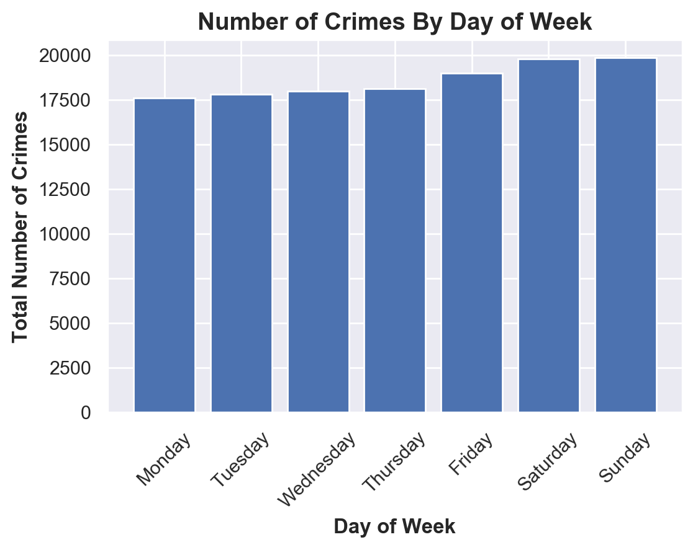
Day of Week vs Crime Findings

Slide 8
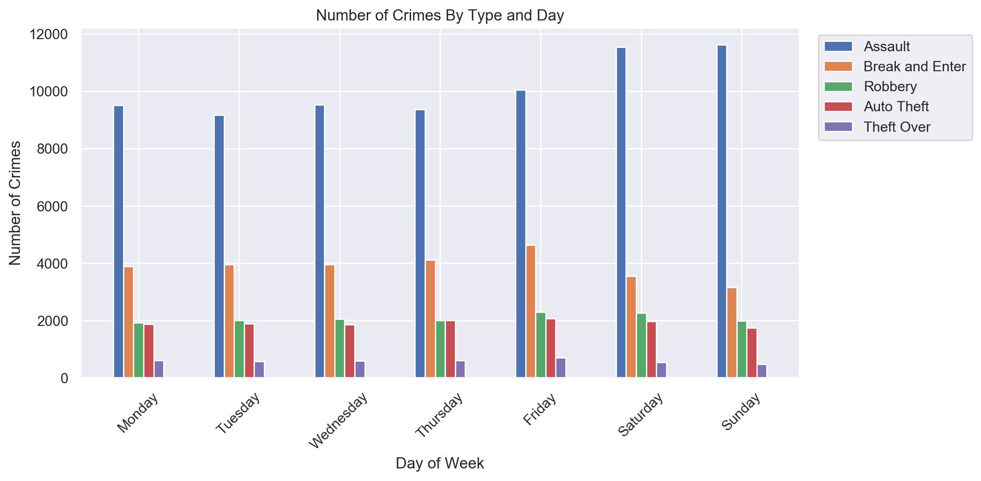
Day of Week vs Crime Findings

Slide 9
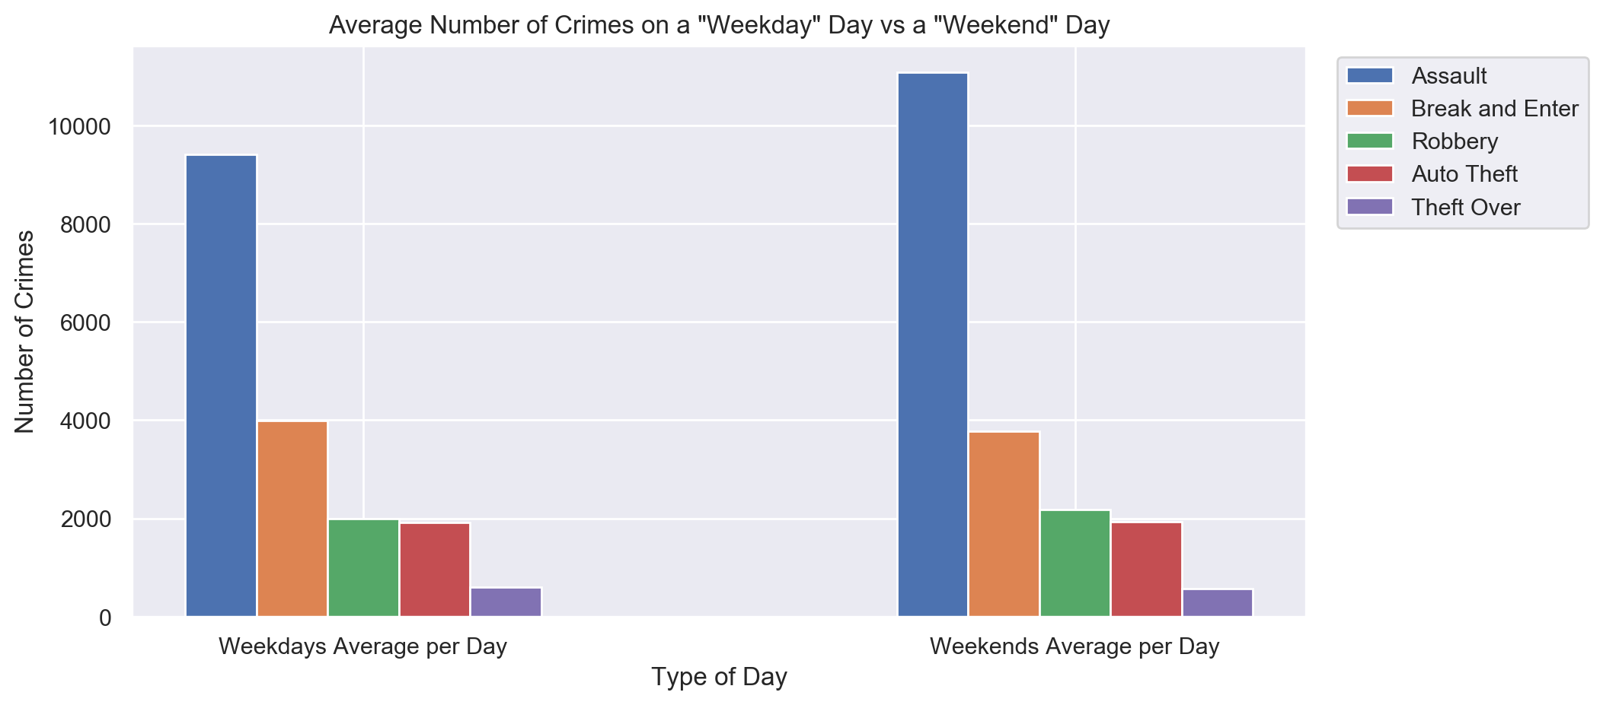
Day of Week vs Crime Findings

Slide 10
Day of Week vs Crime Conclusions and Limitations
From the 5 categories of crime considered for this project, ‘Assault’ has by far the highest number of occurances
The total crime rate goes up during the weekend.
The spike on the weekends is primarily driven by ‘Assault’.
‘Break and Enter’ peaks on Fridays and goes down to the lowest over Saturdays and Sundays.

Slide 11
Day of Week vs Crime Conclusions and Limitations
Conclusions
The total crime rate goes up during the weekend, primarily driven by ‘Assault’.
‘Break and Enter’ peaks on Fridays and goes down to the lowest on Sundays through Saturdays.
Limitations
The only factor considered for this section of the project is Weekday/Weekend vs Crime. Whereas there can be a lot of factors that affect crime.

Slide 12
Whether Weather Drives Crime Agenda
Introduction, Problem Statement and Scope
Methodology
Day of Week vs Crime
Findings
Conclusions
Precipitation vs Crime
Findings
Conclusions
Temperature vs Crime
Findings
Conclusions
Moon Phase vs Crime
Findings
Conclusions

Slide 13
Precipitation vs Crime Findings
CONTENT

Slide 14
Precipitation vs Crime Conclusions
CONTENT

Slide 15
Whether Weather Drives Crime Agenda
Introduction, Problem Statement and Scope
Methodology
Day of Week vs Crime
Findings
Conclusions
Precipitation vs Crime
Findings
Conclusions
Temperature vs Crime
Findings
Conclusions
Moon Phase vs Crime
Findings
Conclusions

Slide 16
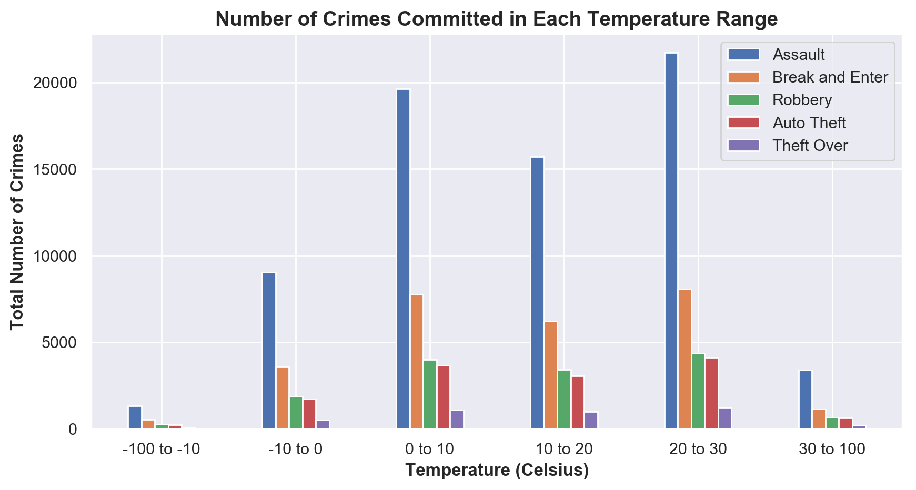
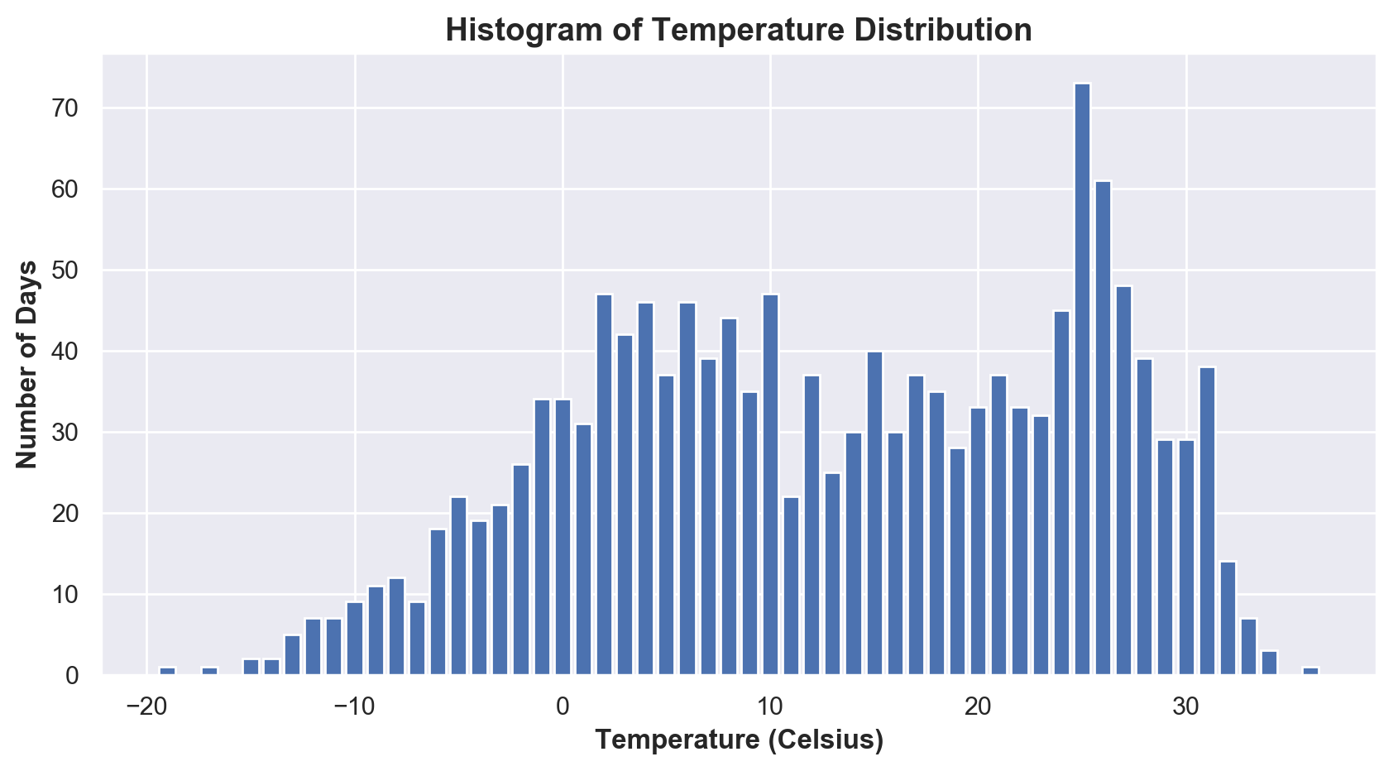
Temperature vs Crime Findings
But there might just be more days with these temperatures!

Slide 17
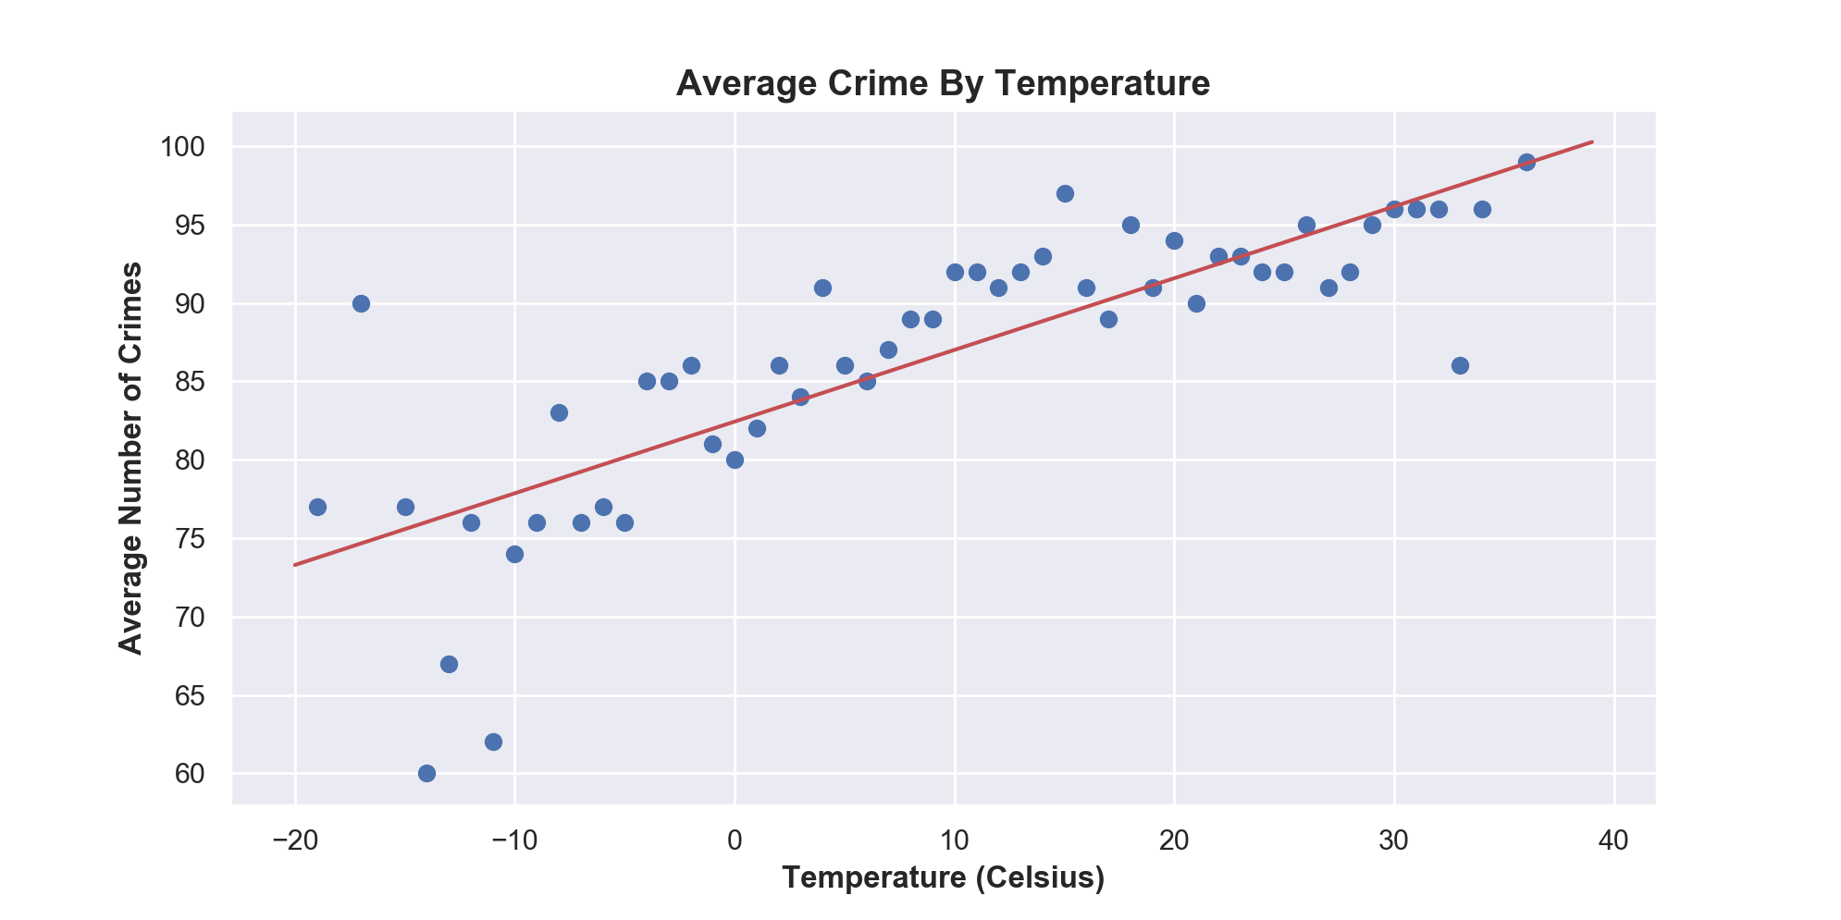
Temperature vs Average Crime Findings
Average Crime By Temperature.png

Slide 18
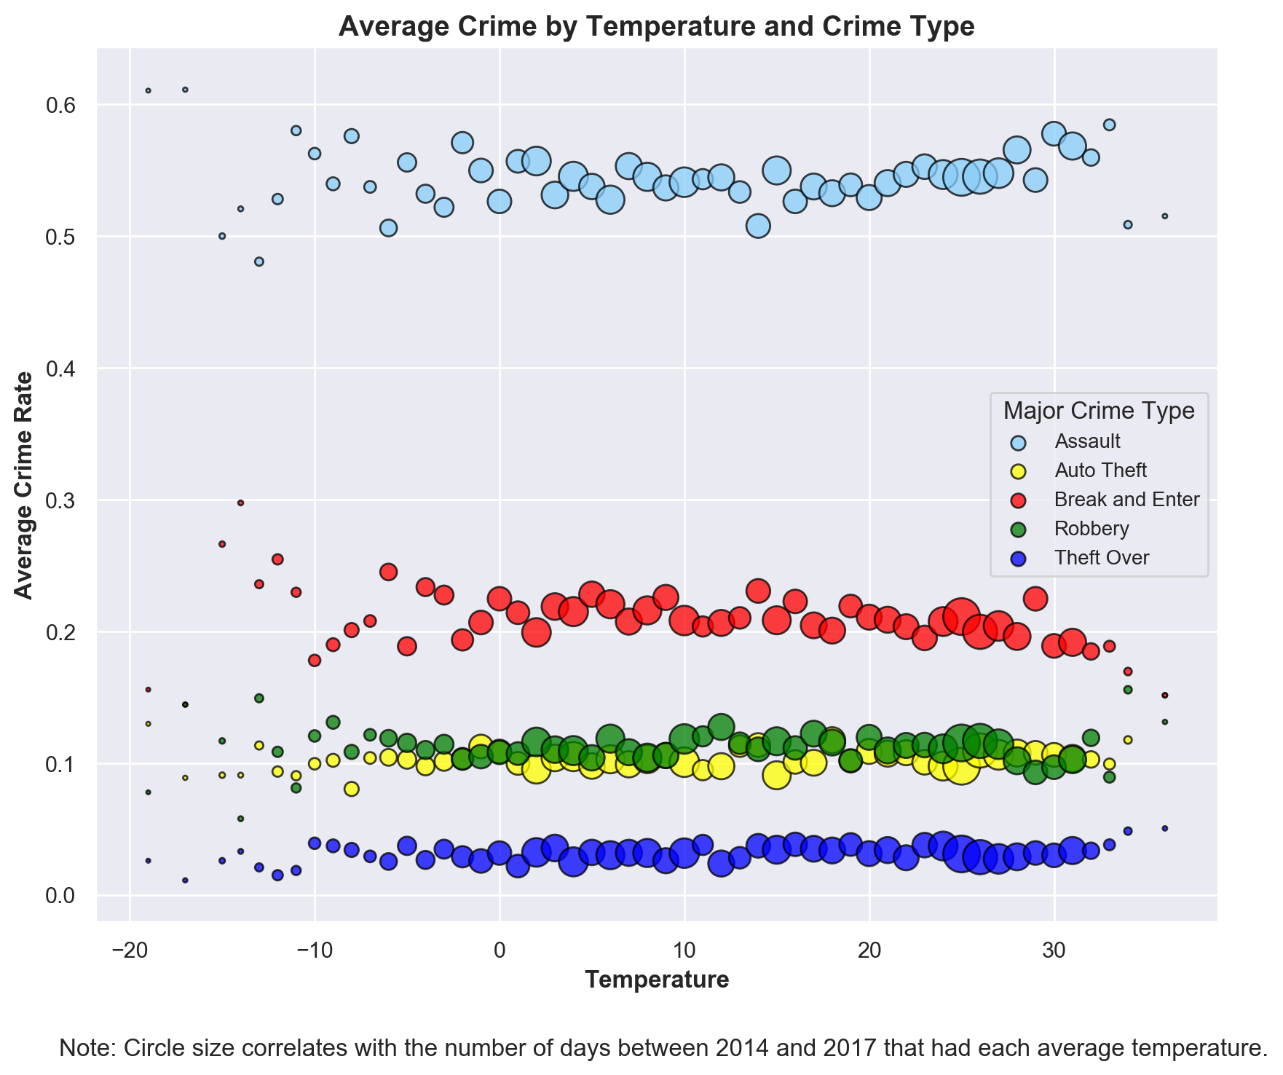
Temperature vs Average Crime Findings
Average Crime By Temperature.png

Slide 19
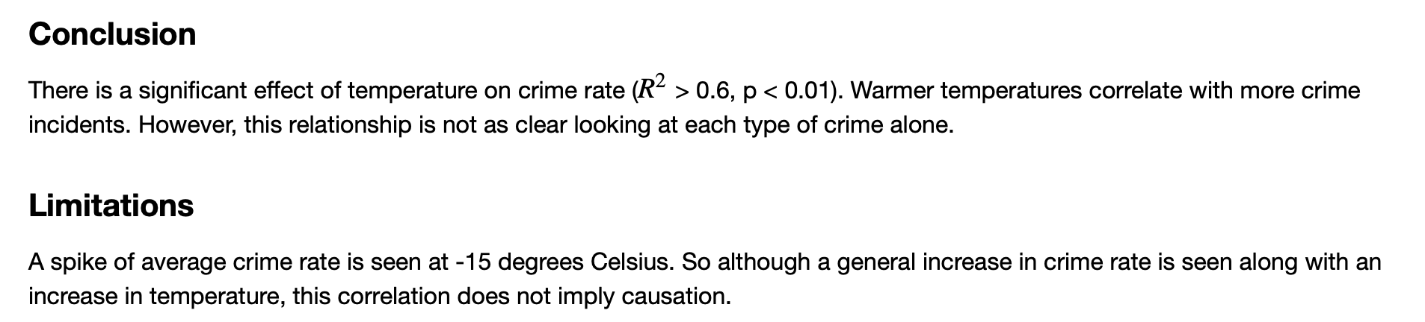
Temperature vs Crime Conclusions and Limitations

Slide 20
Whether Weather Drives Crime Agenda
Introduction, Problem Statement and Scope
Methodology
Day of Week vs Crime
Findings
Conclusions
Precipitation vs Crime
Findings
Conclusions
Temperature vs Crime
Findings
Conclusions
Moon Phase vs Crime
Findings
Conclusions

Slide 21
Moon Phase vs Crime Findings
CONTENT

Slide 22
Moon Phase vs Crime Conclusions
CONTENT

Slide 23
Thank You

